Slide 1
prismo.ai
Statistical Techniques
for
Business Forecasting

Slide 2
CONTENTS – Part I
prismo.ai
SL No. | Topics
1 | Introduction to business forecasting
2 | Regression analysis and forecasting
3 | Exploring time series data
4 | Time series decomposition
5 | Exponential smoothing methods
6 | Autoregressive integrated moving average (ARIMA) models
7 | Intervention models and dynamic regression

Slide 3
prismo.ai
INTRODUCTION
to
BUSINESS FORECASTING

Slide 4
prismo.ai
INTRODUCTION
Forecast
A prediction of some future event or events
Example:
The number of 2-wheeler sales in Bangalore during next month
The average volume of an airline passengers in the next quarter
Field of applications
Business and industry | Medicine
Government | Social science
Economics | Politics
Environmental science | Finance

Slide 5
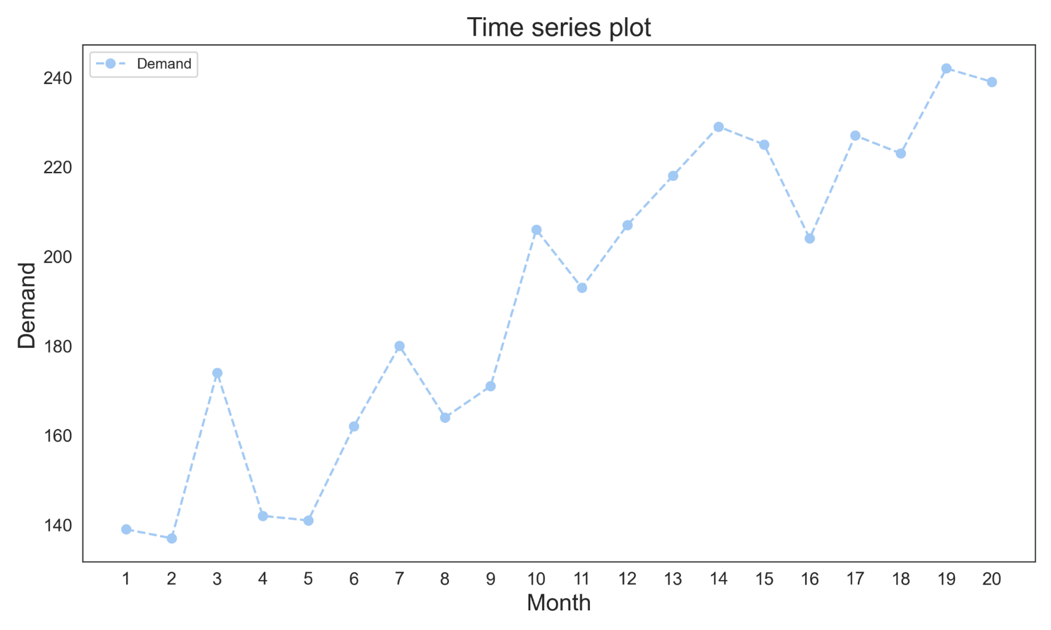
The graphical representation of time series data by taking time on x axis and data on y axis
Plot of data over time
Example: Demand for a commodity for the last 20 months is given below. Draw the time series plot.
.
Notes:
Create a basic plot using python.

Slide 6
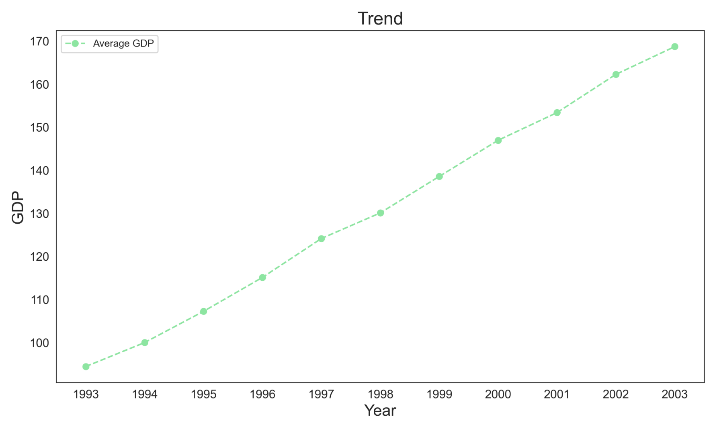
Trend: Long term increase or decrease in the data
Example: Data on yearly average of Indian GDP from the period 1993-2003.

Slide 7
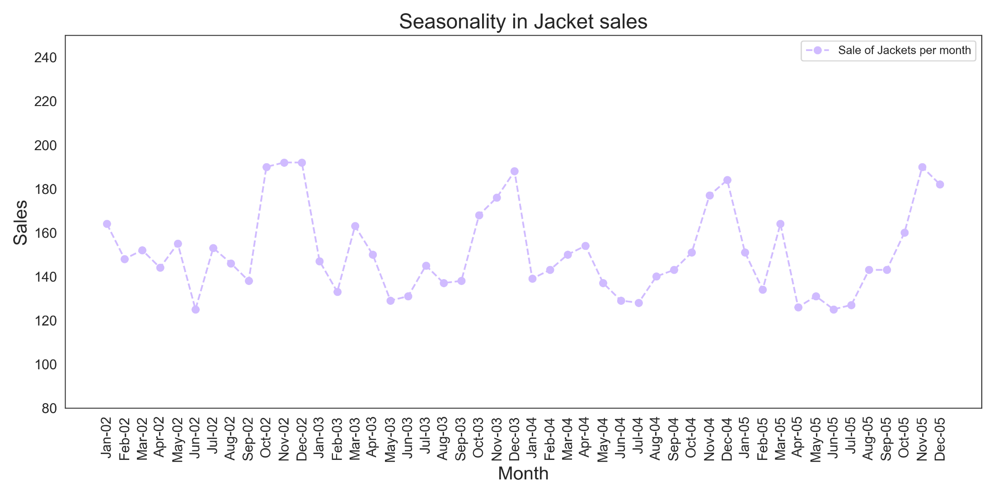
Seasonality: Time series data exhibiting rise and fall based on seasonal factors.
Example: Sale of Branded jackets from January 2002 to November 2005.

Slide 8
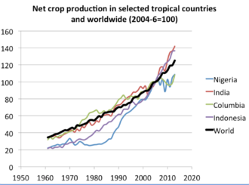

Slide 9
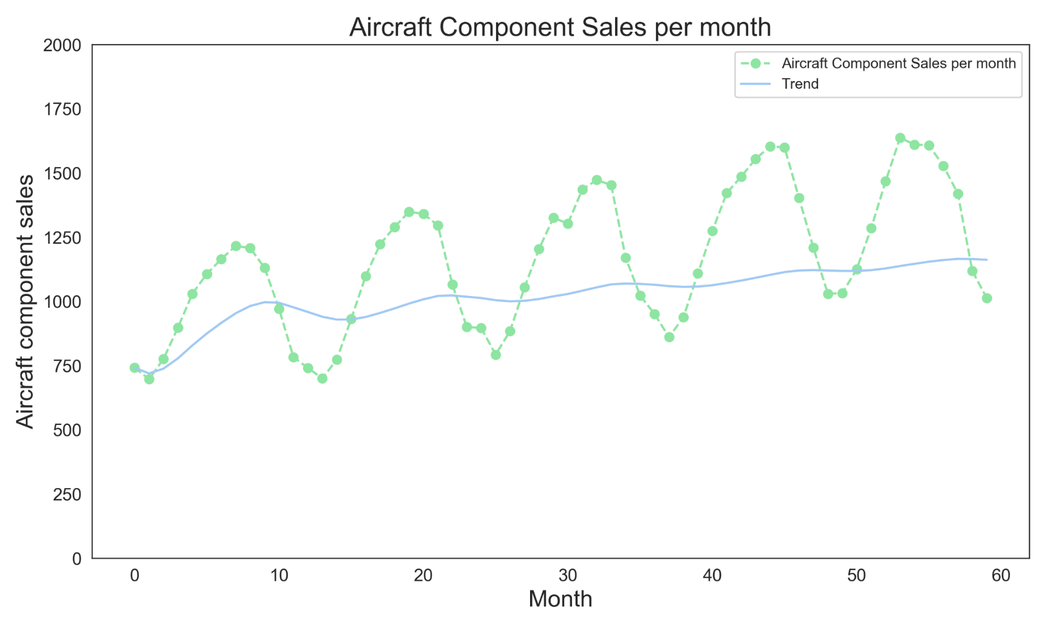
The Time series data may include a combination of trend and seasonal patterns.
Example: Data on the monthly sales of aircraft components are given below.

Slide 10
prismo.ai
INTRODUCTION
Methodology
Based on identifying, modeling and extrapolating the patterns found in historical data
Historical data usually exhibit inertia and do not change dramatically very quickly
Involves use of statistical methods and time series data
Time series
A time oriented or chronological sequence of observations on a variable or metric of interest
A collection of observations or data made sequentially in time
A dataset consisting of observations arranged in chronological order
A sequence of observations over time

Slide 11
prismo.ai
INTRODUCTION
Classification of Forecasting problems
Short -term | Involves predicting events only a few time periods (days, weeks, months) into future
Medium - term | Involves predicting events to one or two years into future
Long - term | Involves predicting events to many years into future
Type | Uses
Short –term & Medium-term | budgeting and selecting new research and development projects
Long - term | Strategic planning

Slide 12
prismo.ai
INTRODUCTION
Applications
Operations Management: Forecasting of product sales or demand for services in order to schedule production, control inventories, manage supply chain, determine staffing or resource requirements and plan capacity
Marketing: Forecasting of sales response to advertising expenditures, new promotions or change in pricing policies to evaluate their effectiveness, determine whether goals are being met and make adjustments
Finance and Risk Management: Forecasting of the return on investments (on financial assets like stocks, bonds, commodities, etc), interest rates, options and currency exchange rates
Economics: Forecasting of major economic variables like gross domestic product, population growth, unemployment, inflation, job growth, production and consumption

Slide 13
prismo.ai
INTRODUCTION
Applications
Industrial Process Control: Forecasting of future values of critical quality characteristics of a production process to determine when important controllable variables in the process need to be changed. Feedback and feed forward control schemes are widely used in monitoring and adjustment of industrial processes.
Demography: Forecasting of population by country and regions often stratified by variables such as gender, age and race to determine spending on health care, retirement programs, anti poverty programs, developing new product lines or types of services to be offered.

Slide 14
prismo.ai
INTRODUCTION
Types of Forecasting Techniques
Qualitative Methods
Quantitative Methods

Slide 15
prismo.ai
INTRODUCTION
Qualitative Methods
Often subjective in nature and require judgement on the part of experts
Used in situations where there is little or no historical data available
Example
Introduction of new product for which there is no relevant history
Approach: Use the expert opinion of sales and marketing personnel to subjectively estimate the product sales during the new product introduction phase of its life cycle
Make use of marketing tests, surveys of potential customers, experience of sales performance of other products (both their own and those of competitors)

Slide 16
prismo.ai
INTRODUCTION
Qualitative Methods: Delphi Method
Most formal and widely known qualitative forecasting technique
Developed by the RAND Corporation
Methodology
Employs a panel of experts who are assumed to be knowledgeable about the problem
The panel members are physically separated to avoid their deliberations being impacted either by peer pressure or by a single dominant individual
Each panel member responds to a questionnaire containing a series of questions and returns the information to a coordinator
Following the first questionnaire, subsequent questions are submitted to the panelists along with information about the opinions of the panel as a group

Slide 17
prismo.ai
INTRODUCTION
Qualitative Methods: Delphi Method
Most formal and widely known qualitative forecasting technique
Developed by the RAND Corporation
Methodology
This allows panelist to review their predictions relative to the opinion of entire group
After several rounds, it is hoped that the opinions of panelists will converge to a consensus, although it is not required and justified differences of opinion can be included in the outcome

Slide 18
prismo.ai
INTRODUCTION
Quantitative Methods
Make use of historical data and forecasting model
Model summarizes patterns in the data and expresses a statistical relationship between previous and current values of the variable
Model is then used to project the patterns in the data into future
Forecasting model use to extrapolate the past and current behavior into the future

Slide 19
prismo.ai
Regression

Slide 20
Definition: Moving Average
A moving average, also called a rolling or running average, is used to analyze the time-series data by calculating averages of different subsets of the complete dataset. Since it involves taking the average of the dataset over time, it is also called a moving mean (MM) or rolling mean.
There are various ways in which the rolling average can be calculated, but one such way is to take a fixed subset from a complete series of numbers. The first moving average is calculated by averaging the first fixed subset of numbers, and then the subset is changed by moving forward to the next fixed subset (including the future value in the subgroup while excluding the previous number from the series).
The moving average is mostly used with time series data to capture the short-term fluctuations while focusing on longer trends.

Slide 21

Definition: Mean Squared Error
The mean squared error (MSE) is largely used as a metric to determine the performance of an algorithm.
The formula to calculate the MSE is as follows:
How to calculate MSE
Calculate the difference between each pair of the observed and predicted value
Take the square of the difference value
Add each of the squared differences to find the cumulative values
In order to obtain the average value, divide the cumulative value by the total number of items in the list

Slide 22

Definition: Mean Squared Absolute Percentage Error
The mean absolute percentage error (MAPE) is a statistical measure of how accurate a forecast system is. It measures this accuracy as a percentage, and can be calculated as the average absolute percent error for each time period minus actual values divided by actual values. Where A_{t} is the actual value and F_{t} is the forecast value, this is given by:

Slide 23
prismo.ai
INTRODUCTION
Widely used Forecasting Models
Regression models
Smoothing models
General time series models

Slide 24
prismo.ai
INTRODUCTION
Regression Models
Make use of relationship between the variable of interest and one or more related predictor variables
Example: Forecasting furniture sales using house purchases as predictor variable

Slide 25
prismo.ai
INTRODUCTION
Smoothing Models
Employs a simple function of previous observations to provide forecast of the variable of interest
May have a formal statistical basis but often used and justified heuristically on the basis that they are easy to use and produces satisfactory results

Slide 26
prismo.ai
INTRODUCTION
General Time series models
Employs the statistical properties of the historical data to specify a formal model and then estimate the unknown parameters of the model (usually) by least square method

Slide 27
prismo.ai
INTRODUCTION
Form of Forecast
Point estimate or point forecast: A single value that represents the best estimate of the future value of the variable of interest
Note: These forecasts are always almost wrong and there will be forecast error
Forecast error: The difference between the predicted and actual value of the variable of interest
Often a good practice to accompany the forecast with an estimate of how large the forecast error might be
Prediction Interval (PI): A range of values for the future observation.
More useful in decision making than a single value

Slide 28
prismo.ai
INTRODUCTION
Form of Forecast
Point estimate or point forecast: A single value that represents the best estimate of the future value of the variable of interest
Note: These forecasts are always almost wrong and there will be forecast error
Forecast error: The difference between the predicted and actual value of the variable of interest
Often a good practice to accompany the forecast with an estimate of how large the forecast error might be
Prediction Interval (PI): A range of values for the future observation.
More useful in decision making than a single value

Slide 29
prismo.ai
INTRODUCTION
Activities in Forecasting Process:
Problem definition: Involves understanding how the forecast will be used, expectations of the customer or user of the forecast, how often forecast need to be revised, what level of forecast accuracy is required to make good business decision
Data collection: Consists of obtaining the relevant history for the variable(s) to be forecast, including historical information on potential predictor variables
Preliminary data analysis: Needed for selection of the appropriate forecasting model, to identify the patterns such as trends, seasonal and other cyclic components. Numerical summaries such as sample mean, standard deviation, percentiles and auto correlations need to be computed and evaluated. Unusual observations or potential outliers need to be identified and flagged for possible further study. If predictor variables are involved, scatter plots of each pair of variables should be examined

Slide 30
prismo.ai
INTRODUCTION
Activities in Forecasting Process:
Model selection and fitting: Choosing one or more forecasting models and fitting the model to the data (estimating the unknown parameters of the model)
Model validation: Evaluation of the forecasting model to determine how it is likely to perform in the intended application. The magnitude of forecast error need to be examined not only on historical data but also on fresh or new data
Forecast model deployment: Consists of using the model to forecast the future values of the variable of interest for the customer
Monitoring forecasting model performance: An ongoing activity after the model has been deployed to ensure that the model still performing satisfactorily. Monitoring of forecast errors is an essential part of good forecasting system design. Control charts of forecast errors are simple and effective way to routinely monitor the performance of a forecasting model

Slide 31
prismo.ai
REGRESSION ANALYSIS
Regression
Correlation helps
To check whether two variables are related
If related
Identify the type & degree of relationship

Slide 32
prismo.ai
REGRESSION ANALYSIS
Regression
Regression helps
To identify the exact form of the relationship
To model output in terms of input or process variables
Examples:
Expected (Yield) = 5 + 3 x Time - 2 x Temperature

Slide 33
prismo.ai
REGRESSION ANALYSIS
Simple Linear Regression Illustration
Output variable is modeled in terms of only one variable
Regression Model
y = 1 + 3x

Slide 34
prismo.ai
REGRESSION ANALYSIS
Simple Linear Regression
General Form:
y= a + bx +ε
where
a: intercept (the value of y when x is equal to 0)
b: slope (indicates the amount of change in y with every unit change in x)

Slide 35
prismo.ai
REGRESSION ANALYSIS
Simple Linear Regression: Parameter Estimation
Model: y = a + bx + ε
Test for Significance (Testing b = 0 or not) of relation between x & y
H0: b = 0
H1: b ≠ 0
Test Statistic
If p value < 0.05, then H0 is rejected & y can be modeled with x

Slide 36
prismo.ai
REGRESSION ANALYSIS
Regression illustration: Example

Slide 37
prismo.ai
REGRESSION ANALYSIS
Regression Model y = 76.32 - 0.42x + ε

Slide 38
prismo.ai
REGRESSION ANALYSIS
Regression: Issues
For any set of data,
a & b can be calculated
Regression model y = a + bx + ε can be build
But all the models may not be useful

Slide 39
prismo.ai
REGRESSION ANALYSIS
Coefficient of Regression: Measure of degree of Relationship
Symbol : R²
R² = SS_{R}/ Syy = b.Sxy/ Syy
SS_{R} = Σ(y_{predicted} - Mean y)²
Syy = Σ(y_{actual} - Mean y)²
R² : amount variation in y explained by x
Range of R² : 0 to 1
If R² ≥ 0.6, the Model is reasonably good

Slide 40
prismo.ai
REGRESSION ANALYSIS
Coefficient of Regression: Testing the significance of Regression
Regression ANOVA
Model | SS | df | MS | F | p value
Regression | SS_{R}
Residual | Syy – SS_{R}
Total | Syy
If p value < 0.05, then the regression model is significant

Slide 41
prismo.ai
REGRESSION ANALYSIS
Multiple Linear Regression
To model output variable y in terms of two or more variables.
General Form:
y = a + b₁x₁ + b₂x₂ + - - - + b_{k}x_{k} + ε
Two variable case:
y = a + b₁x₁ + b₂x₂ + ε
Where
a: intercept (the predicted value of y when all x’s are zero)
b_{j}: slope (the amount change in y for unit change in x_{j} keeping all other x’s constant, j = 1,2,---,k)

Slide 42

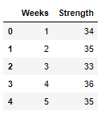
prismo.ai
REGRESSION ANALYSIS
Exercise : The data on the strength of a connector and the age in weeks of the glue used to bond the components of the connector is given in strength file. Develop a model to forecast the strength of the connector using the age of the glue?
Step 1: Read data

Slide 43
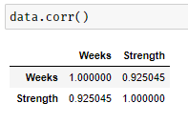
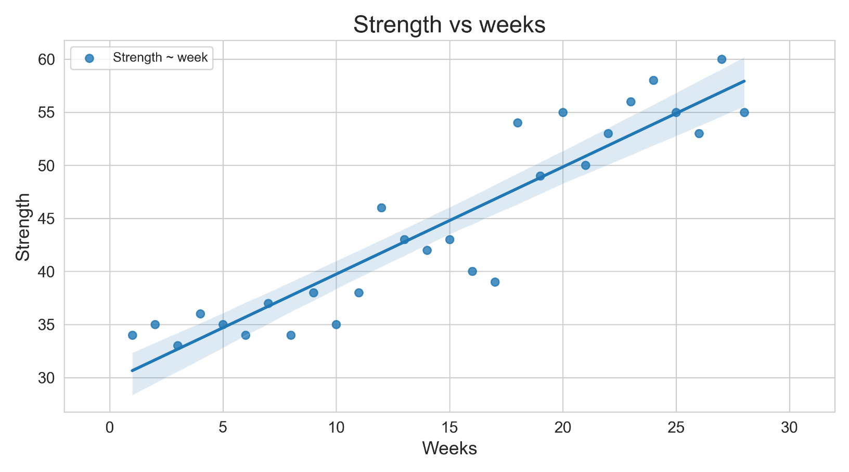
Step 2: Find Correlation
Step 3: Plot graph

Slide 44
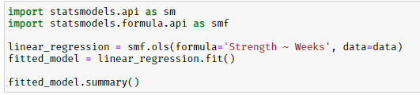
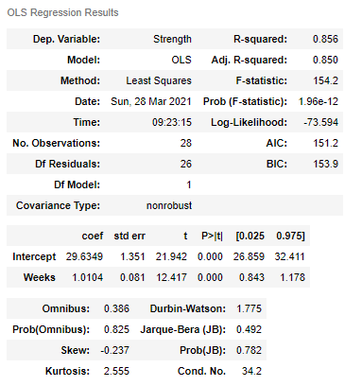
Step 4: Perform Regression
Step 5: Regression Output
Statistic | Value | Criteria
R Square | 0.856 | ≥ 0.6
Adjusted R Square | 0.850 | ≥ 0.6

Slide 45


Step 6: Perform Regression ANOVA
Regression Criteria: P value < 0.05
Step 7: ANOVA Output
Regression ANOVA
Model | SS | df | MS | F | p value
Regression | 1865.198 | 1 | 1865.198 | 154.2 | 0.0000
Residual | 314.5167 | 26 | 12.0968
Total | 2179.714 | 27
Criteria: P value < 0.05

Slide 46

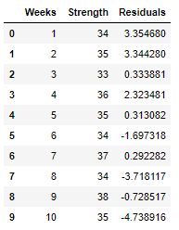
Step 8: Residual Analysis
Step 8A: Calculate Residuals

Slide 47
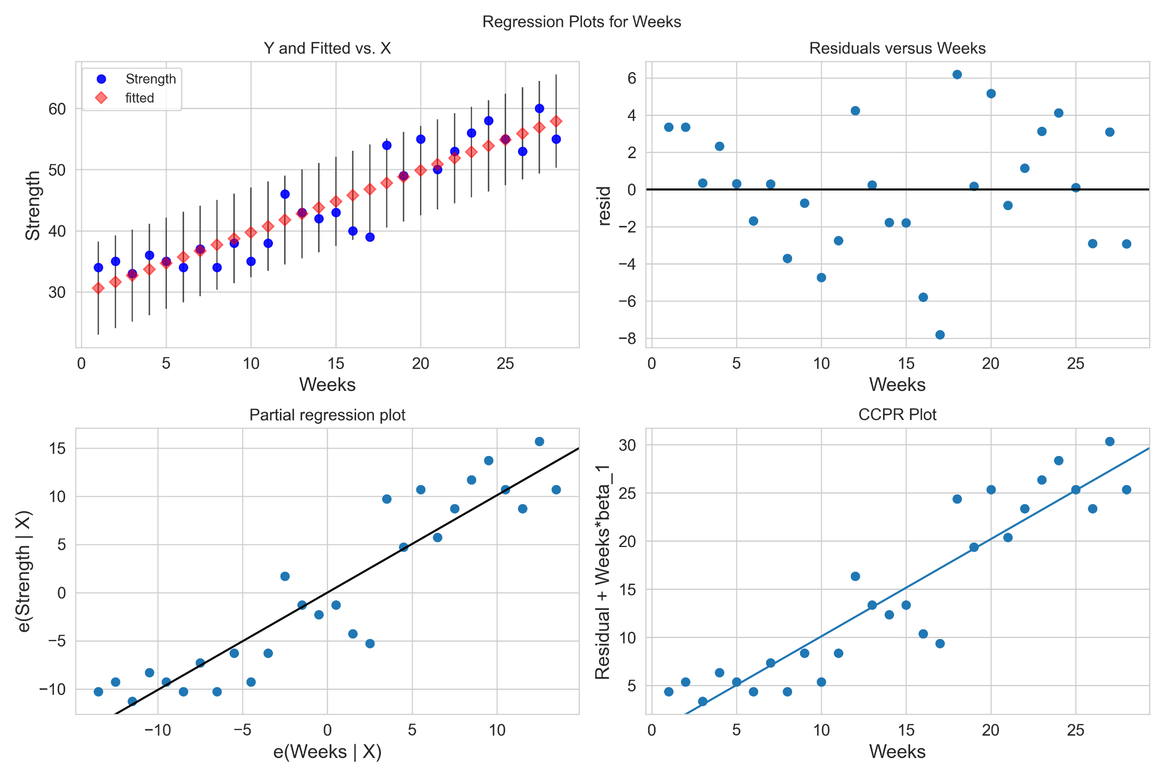
Step 8B: Plot Residuals

Slide 48

Step 8C: Test for Normality: Shapiro Wilks test
The Shapiro-Wilk test tests the null hypothesis that the residuals form a normal distribution.
Result:

Slide 49

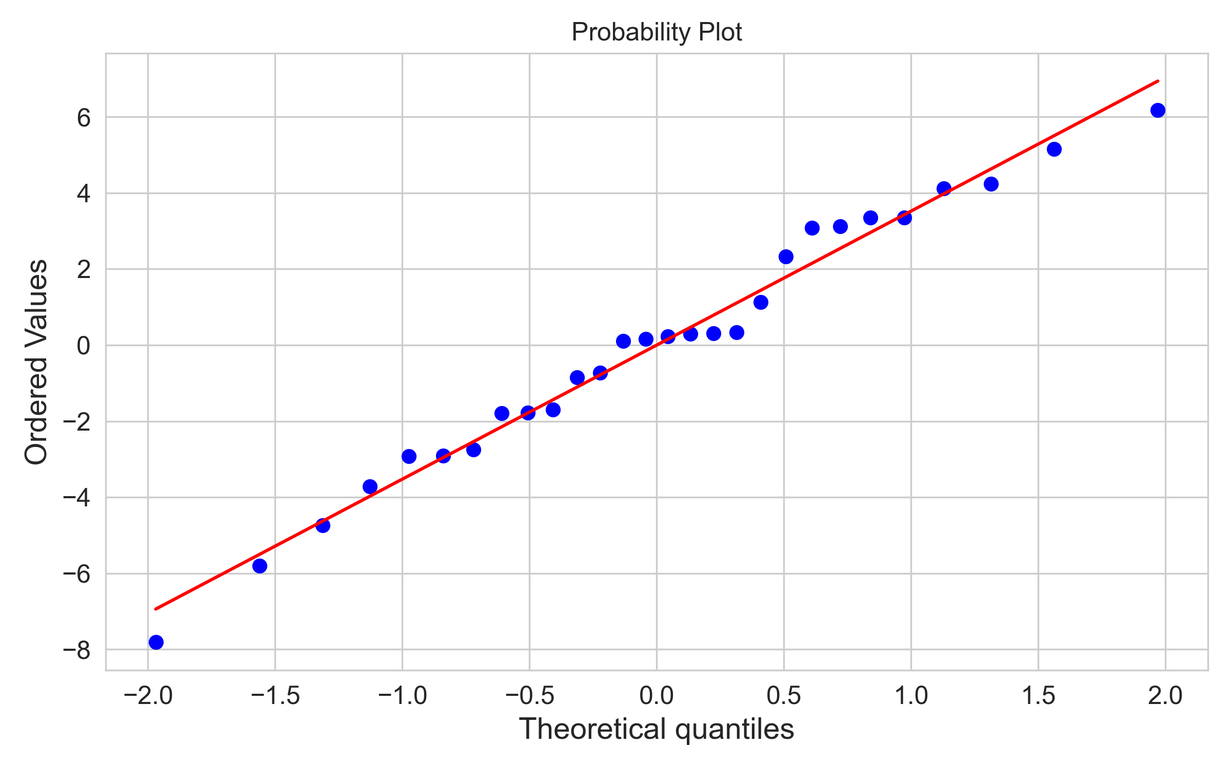
We can apply normal probability plot to assess how the data (error) depart from normality visually:

Slide 50
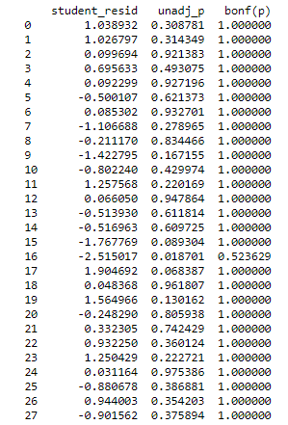
Step 8D: Bonferroni Outlier Test
Observations with Bonferonni p – value < 0.05 are potential outliers.
Result: Bonferroni Outlier Test
As we can see from the adjusted p values, there are no outliers according to the Bonferroni test.

Slide 51
prismo.ai
REGRESSION ANALYSIS
Exercise : The effect of temperature and reaction time affects the % yield. The data collected in given in the Mult-Reg_Yield file. Develop a model for % yield in terms of temperature and time?

Slide 52
prismo.ai
Thank You

